Slide 1


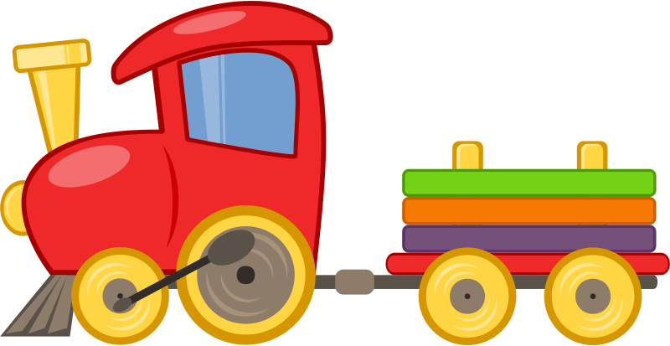



Slide 2
TRAIN

Slide 3
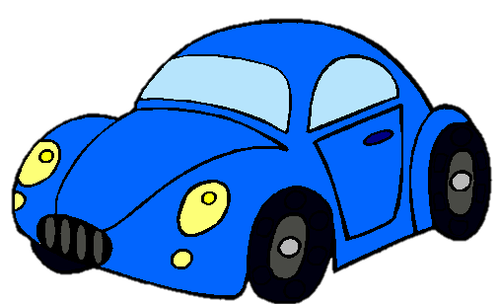
CAR

Slide 4

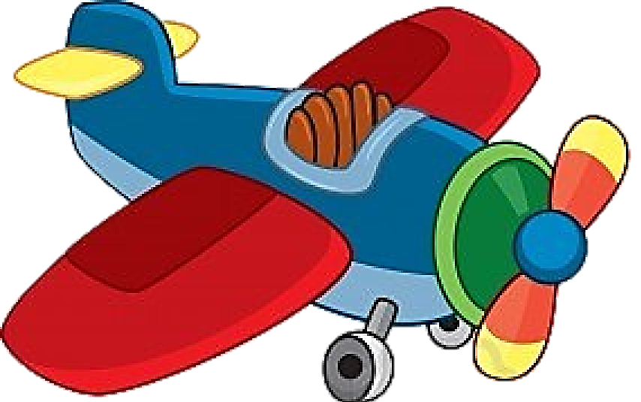

Slide 5
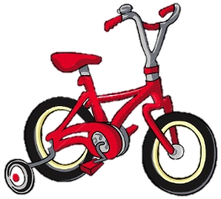
BICYCLE

Slide 6
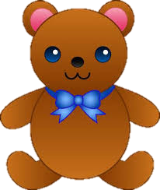
TEDDY BEAR

Slide 7
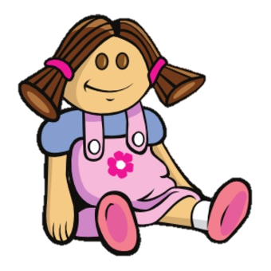
DOLL

Slide 8
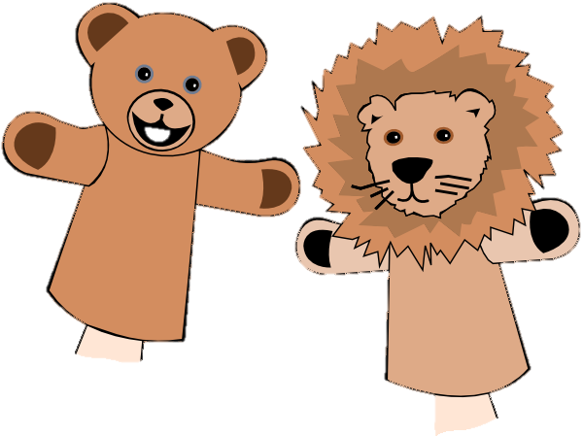
PUPPET

Slide 9
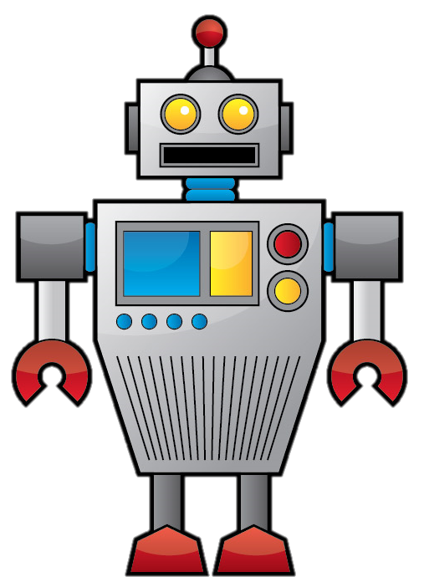
ROBOT

Slide 10

BALL

Slide 11
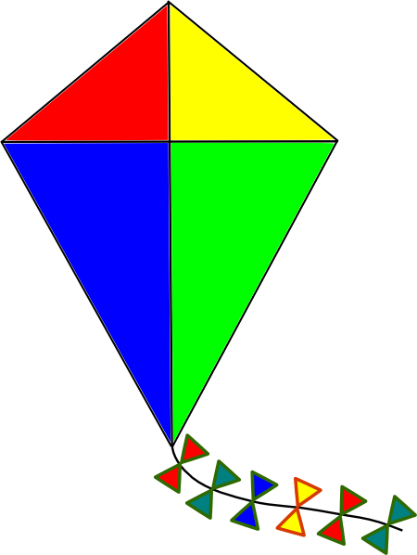
KITE

Slide 12
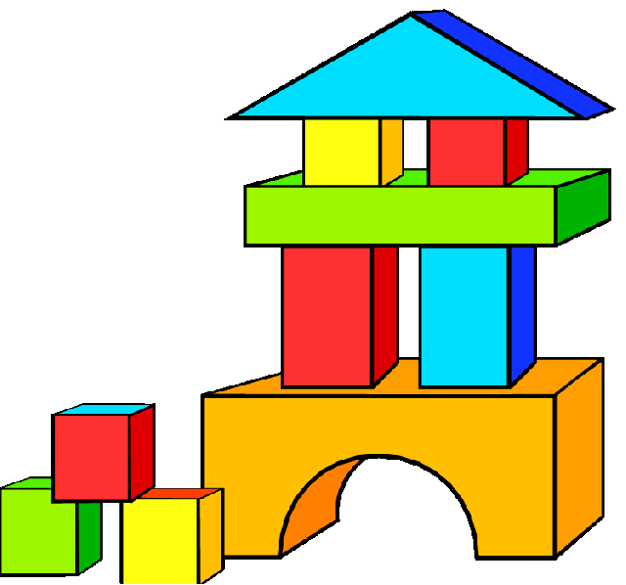
BUILDING BLOCKS

Slide 13
GUESS
THE TOY
START

Slide 14
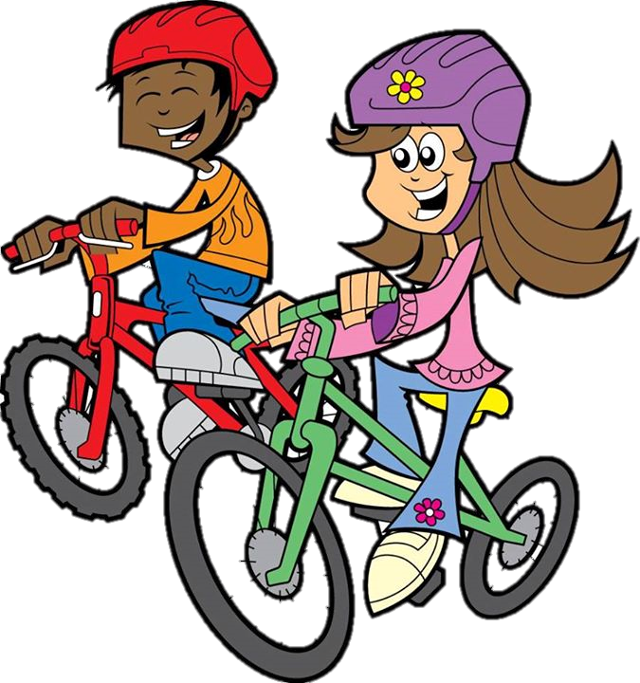
bicycles
The kids are riding their ___________
NEXT
CHECK

Slide 15
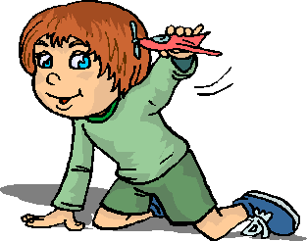
aeroplane
The kid is playing with an _____________
NEXT
CHECK

Slide 16
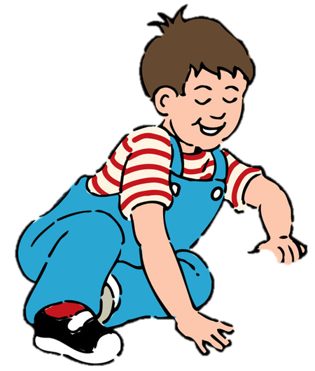
car
This boy is playing with a ___________
NEXT
CHECK

Slide 17
train
He is playing with a ___________
NEXT
CHECK

Slide 18
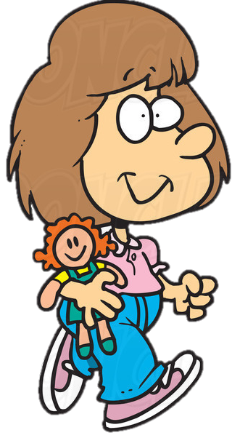
doll
The girl has got a _________
NEXT
CHECK

Slide 19
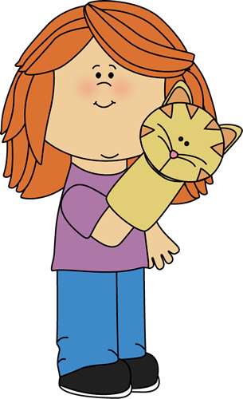
puppet
This girl has got a __________
NEXT
CHECK

Slide 20
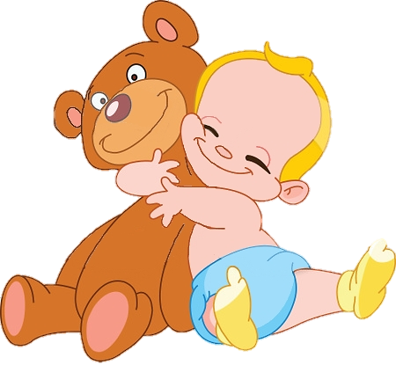
teddy bear
The baby has got a ______________
NEXT
CHECK

Slide 21
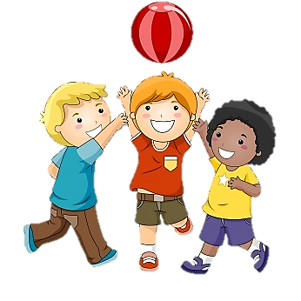
ball
The kids are playing with a ________
NEXT
CHECK

Slide 22
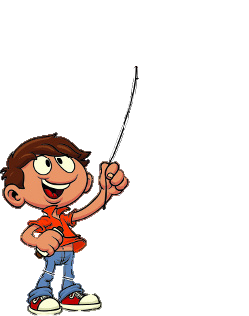
kite
This boy is playing with his ________
NEXT
CHECK

Slide 23
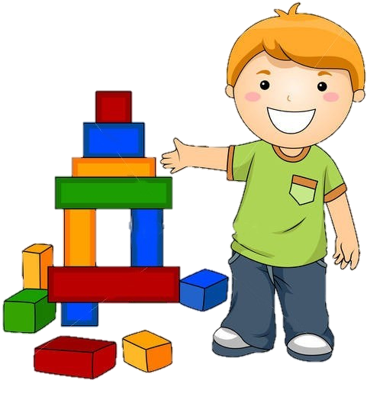
building blocks
The boy is playing with his _________________
NEXT
CHECK

Slide 24

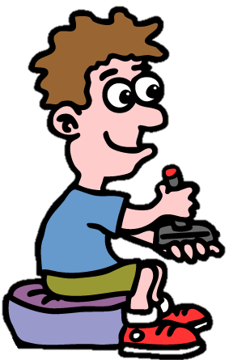
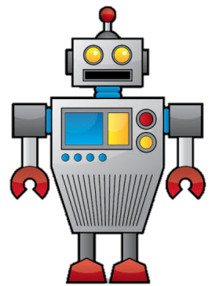
robot
The boy is playing with his ________
CHECK
EXIT

