Slide 1
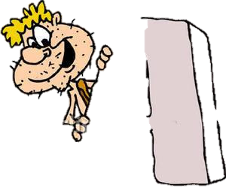


THE
ALPHABET
ONG

Slide 2
















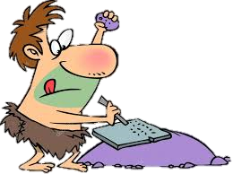










and
and

Slide 3
Now I know my A B C
26 letters from A to Z
LISTEN AGAIN
NEXT

Slide 4
Guess the word beginning with the letter shown.
Press Check and pass the cursor over the letters to spell the word.

Slide 5
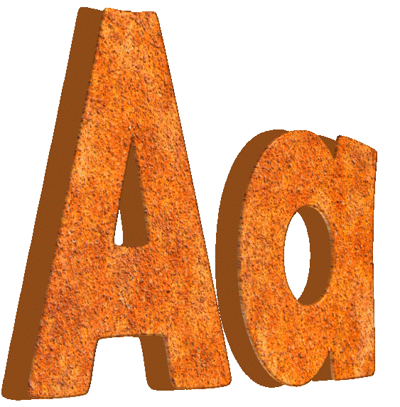

[eɪ] for …
l
a
p
p
e
CHECK
NEXT
Pass the cursor over the letters to spell the word

Slide 6


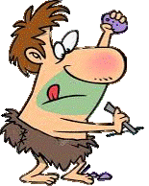
[biː] for …
b
e
e
CHECK
NEXT

Slide 7
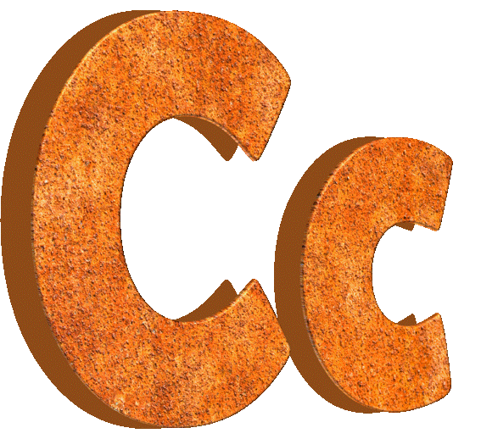
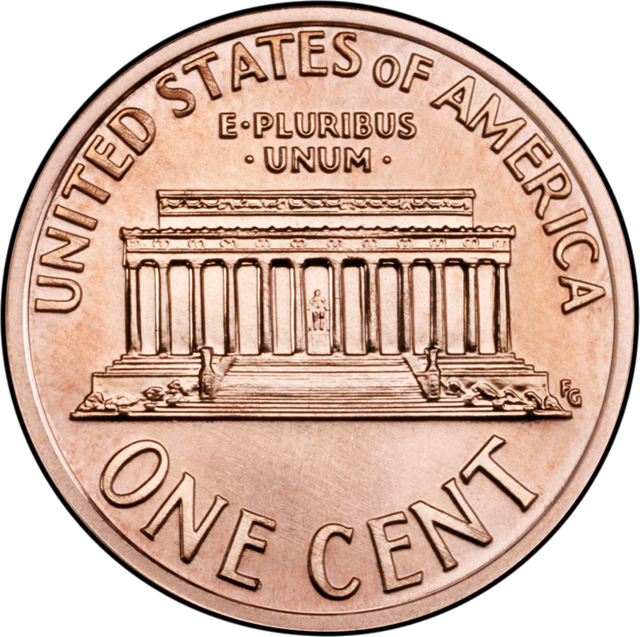
[siː] for …
t
c
e
n
CHECK
NEXT

Slide 8
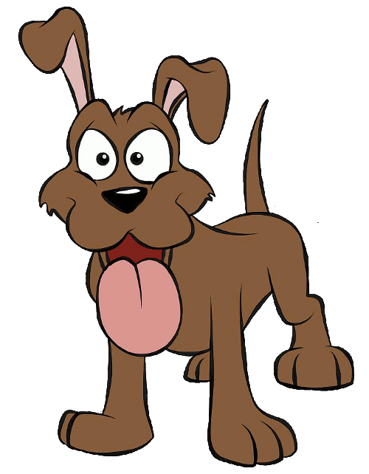
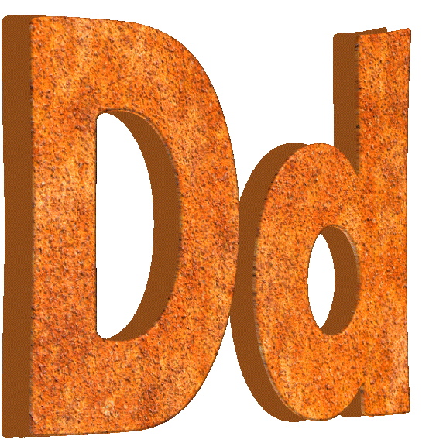
[diː] for …
d
o
g
CHECK
NEXT

Slide 9
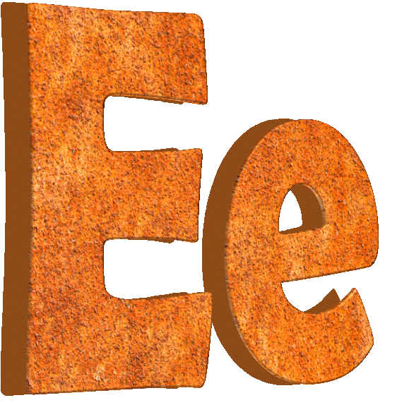
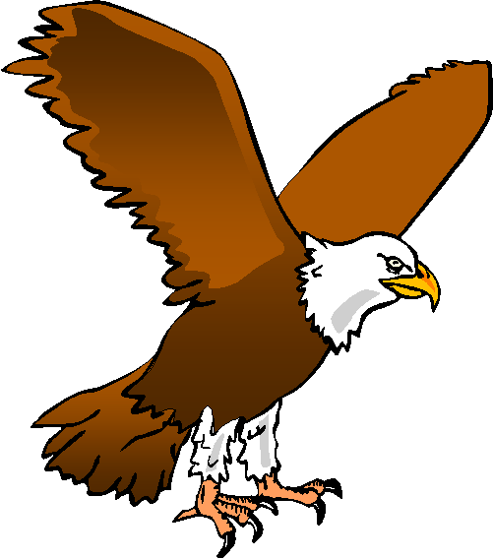
[iː] for …
l
e
a
g
e
CHECK
NEXT

Slide 10


[ef] for …
f
h
i
s
CHECK
NEXT

Slide 11

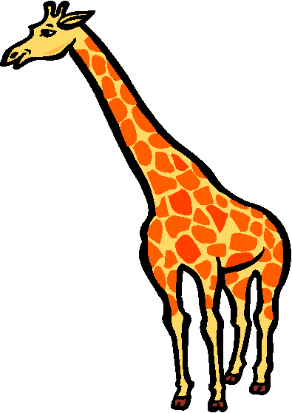
[dʒiː] for …
f
f
i
g
r
a
e
CHECK
NEXT

Slide 12


[eɪtʃ] for …
h
d
a
n
CHECK
NEXT

Slide 13

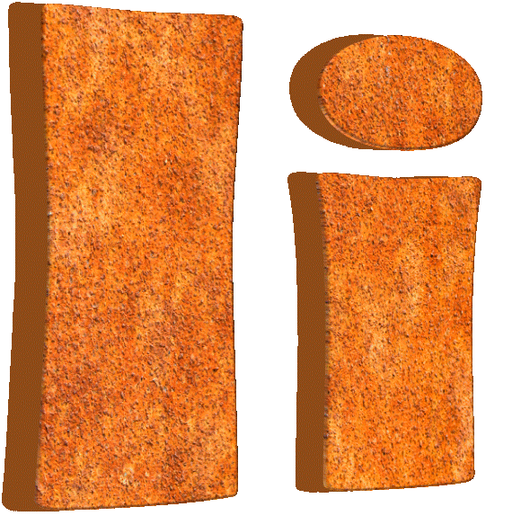
[aɪ] for …
i
c
e
c
r
e
a
m
CHECK
NEXT

Slide 14
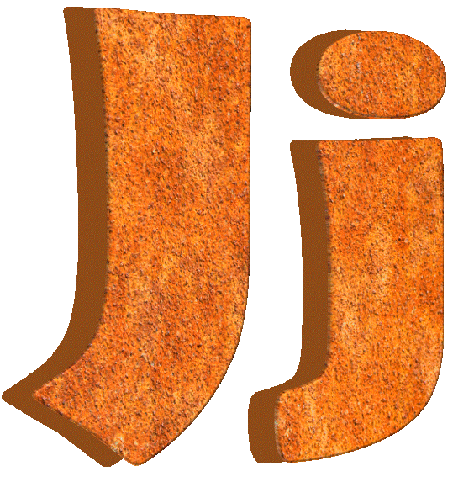
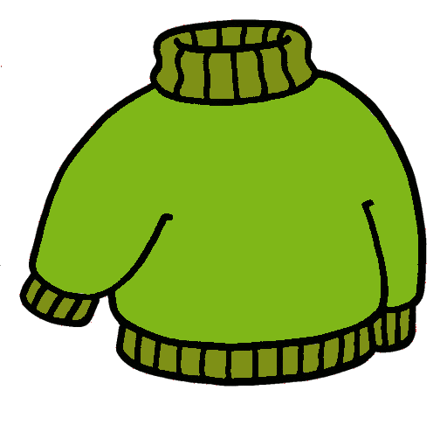
[dʒeɪ] for …
j
u
m
p
e
r
CHECK
NEXT

Slide 15

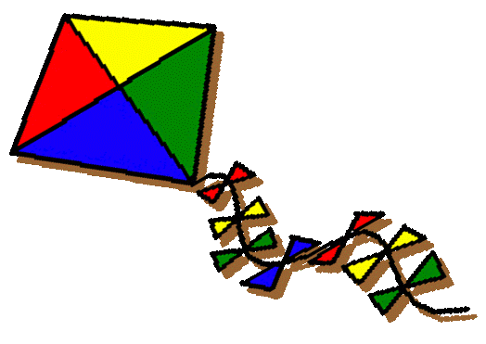
[keɪ] for …
k
t
i
e
CHECK
NEXT

Slide 16

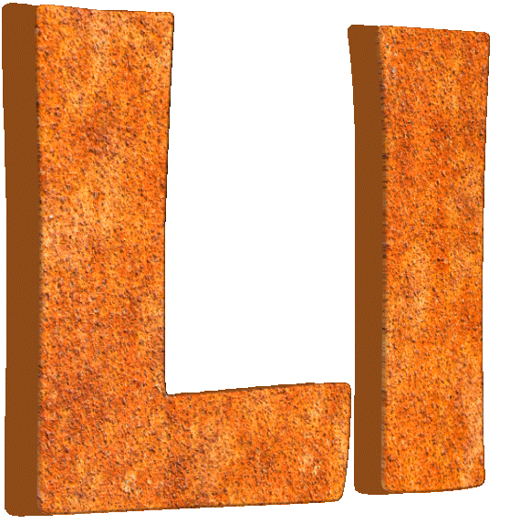
[el] for …
l
f
e
a
CHECK
NEXT

Slide 17


[em] for …
m
o
o
n
CHECK
NEXT

Slide 18
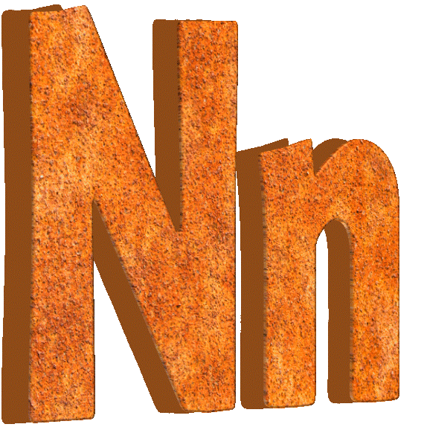
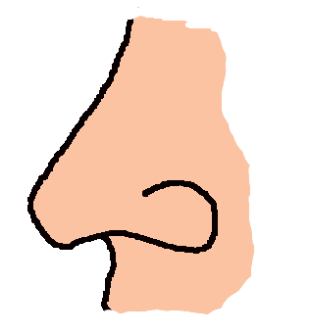
[en] for …
n
o
s
e
CHECK
NEXT

Slide 19
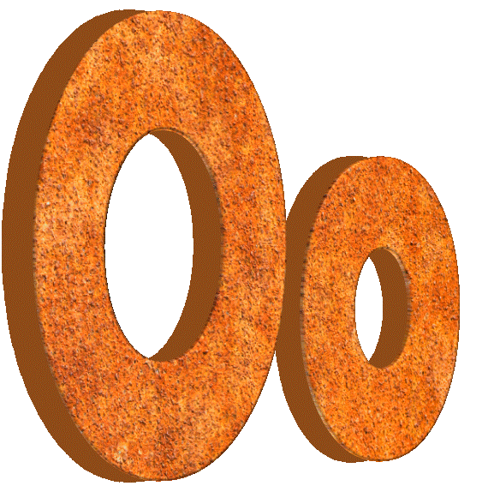
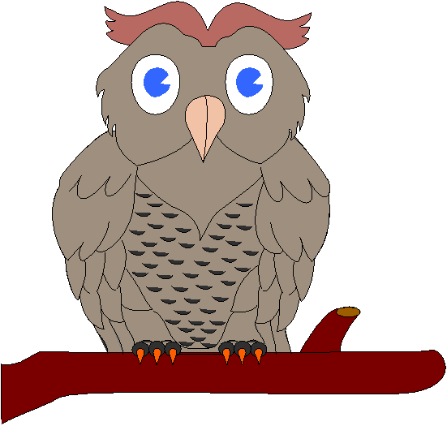
[əʊ] for …
l
o
w
CHECK
NEXT

Slide 20
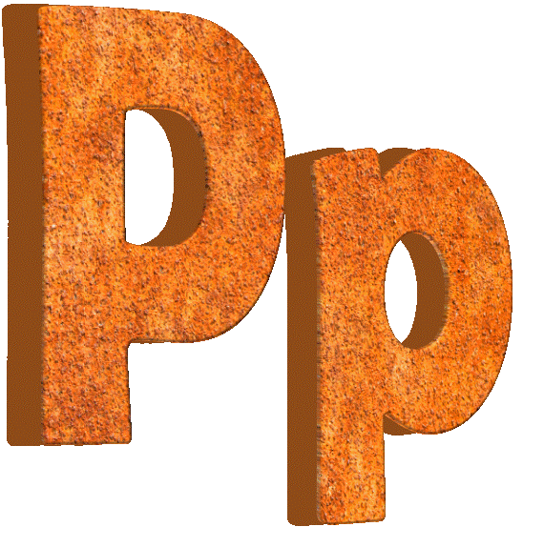
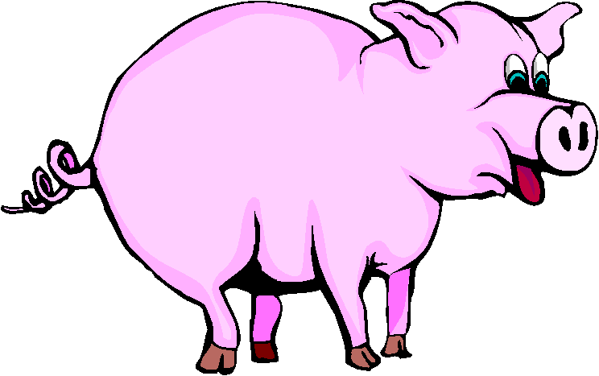
[piː] for …
i
p
g
CHECK
NEXT

Slide 21
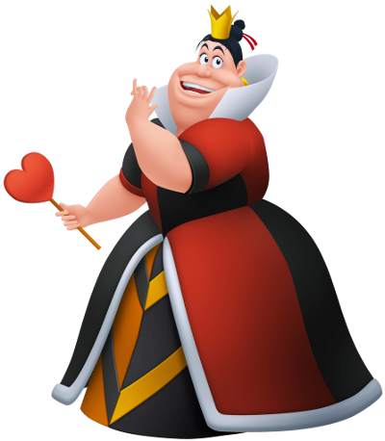
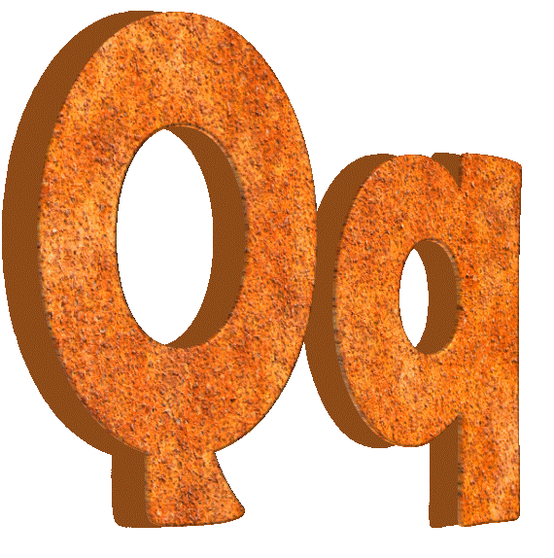
[kjuː] for …
q
u
e
e
n
CHECK
NEXT

Slide 22


[ɑː] for …
r
o
s
e
CHECK
NEXT

Slide 23
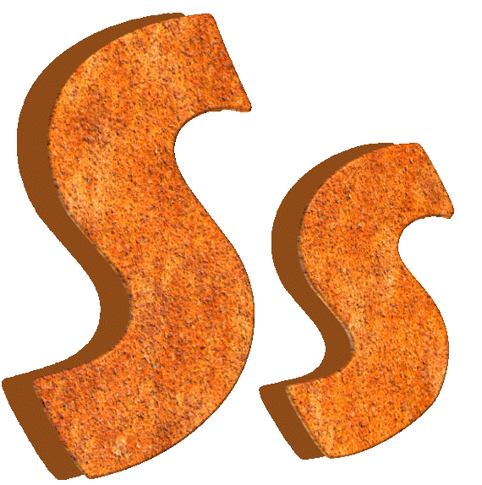
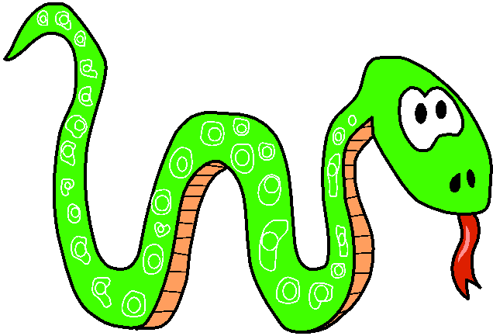
[es] for …
k
s
n
a
e
CHECK
NEXT

Slide 24
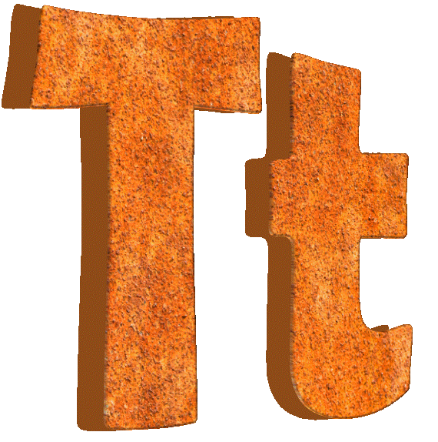

[tiː] for …
t
e
a
CHECK
NEXT

Slide 25


[juː] for …
i
u
n
v
e
r
s
e
CHECK
NEXT

Slide 26
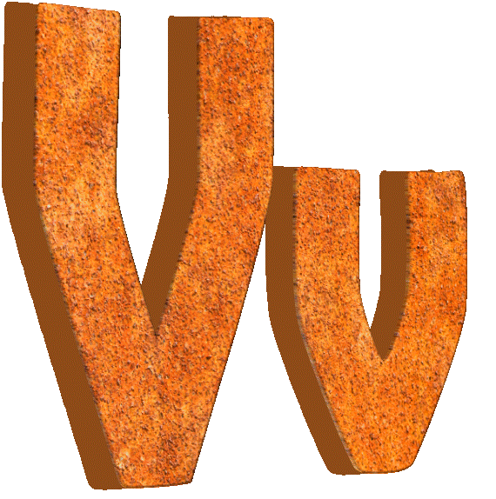
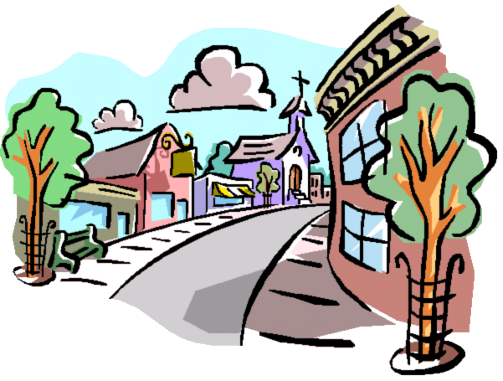
[viː] for …
l
l
i
v
a
g
e
CHECK
NEXT

Slide 27

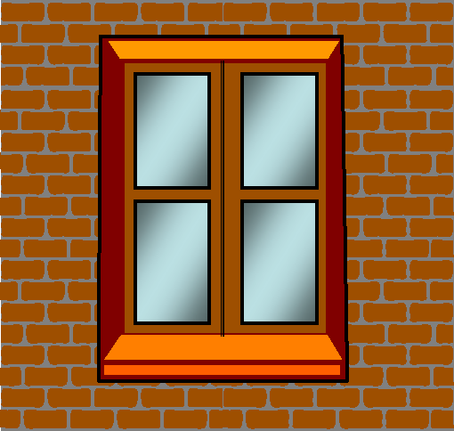
[ˈdʌbəljuː] for …
ˈdʌbəljuː
i
d
w
n
o
w
CHECK
NEXT

Slide 28
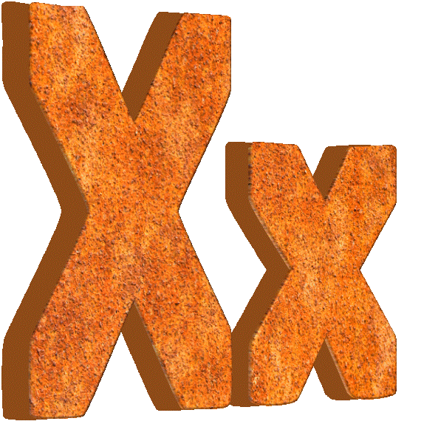
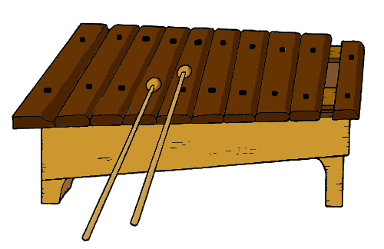
[eks] for …
l
h
x
y
o
p
o
n
e
CHECK
NEXT

Slide 29
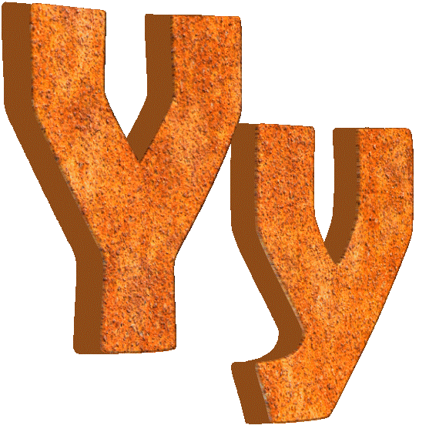

[waɪ] for …
t
y
o
g
u
r
CHECK
NEXT

Slide 30
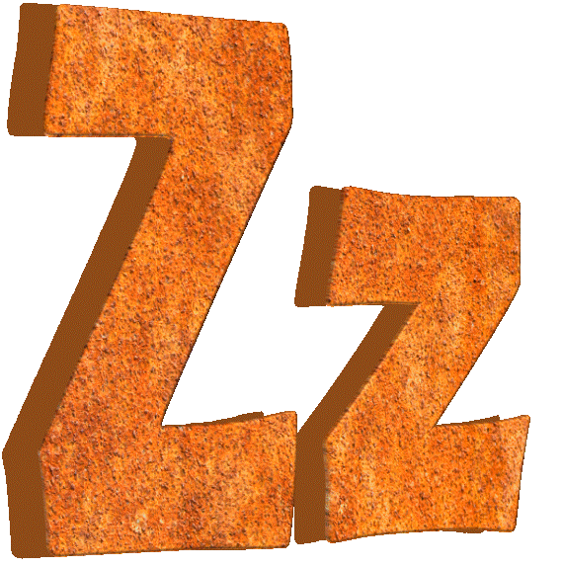
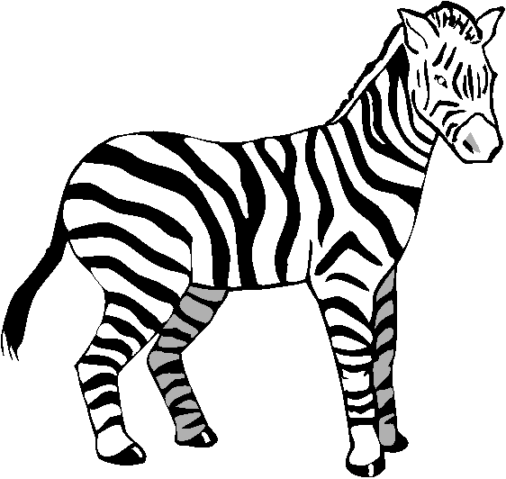
[zed/ziː] for …
b
z
e
r
a
CHECK
EXIT

